Slide 1
Docker Best definition forever "Docker is a cloud computing technology that enables developers to create, deploy, and run applications in a containerized environment. This means that when you develop an application, it can run and be accessed easily on any platform, without worrying about compatibility issues. The beauty and huge advantage of Docker is that it's scalable, meaning that it can handle a large increase in users, from millions to billions to trillions, without affecting performance. This is particularly useful for social media platforms like Facebook and YouTube, which require high scalability to handle massive user bases."Here's a breakdown of the key points:- Docker is a cloud computing technology- It enables developers to create, deploy, and run applications in a containerized environment- Containerization allows applications to run on any platform without compatibility issues- Docker is scalable, meaning it can handle a large increase in users without affecting performance- Scalability is particularly useful for social media platforms and other applications that require high traffic and user engagement.

Slide 3
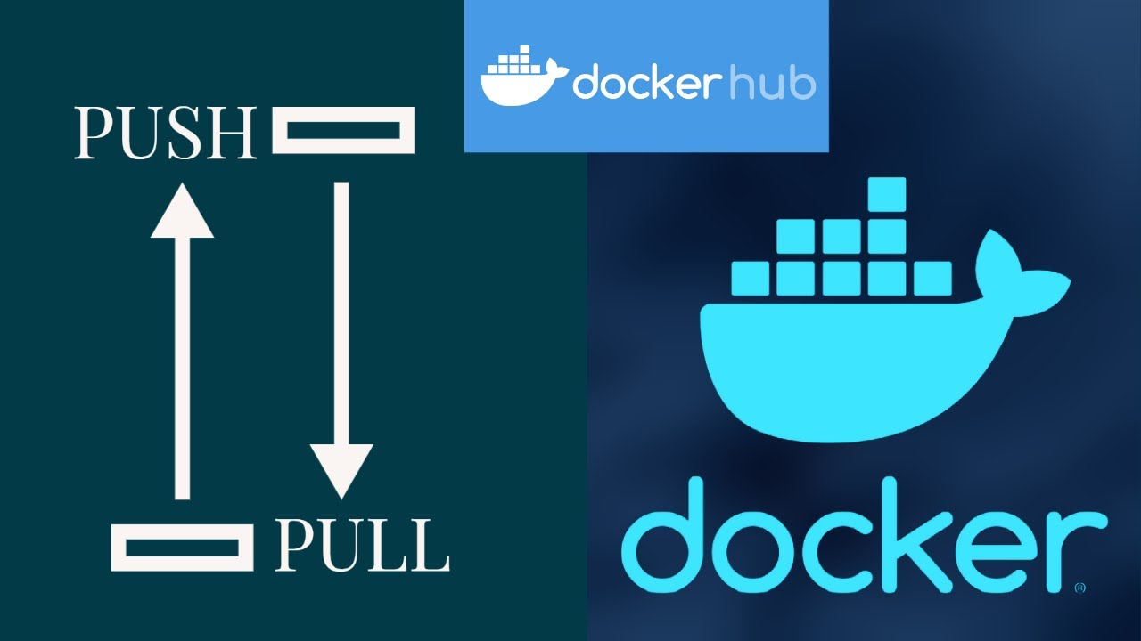

Slide 4
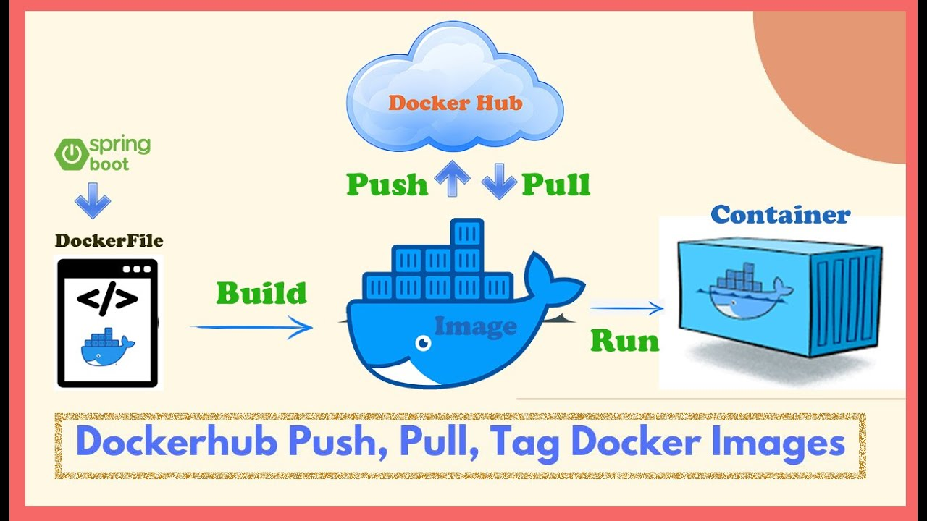

Slide 5
